Slide 1
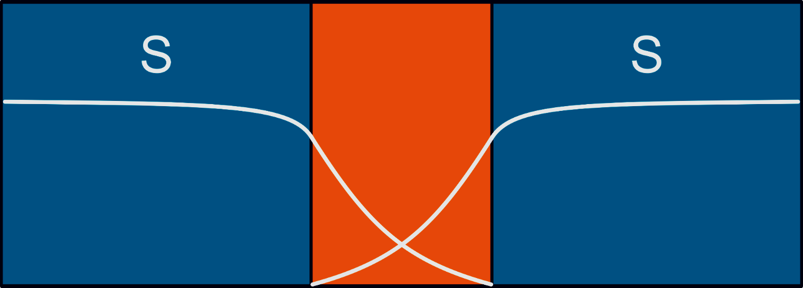


Superconductivity Lecture 5:
Josephson Effect
$${\left|Ψ\right|e}^{ iθ_{1}}$$
$${\left|Ψ\right|e}^{ iθ_{2}}$$

Slide 2
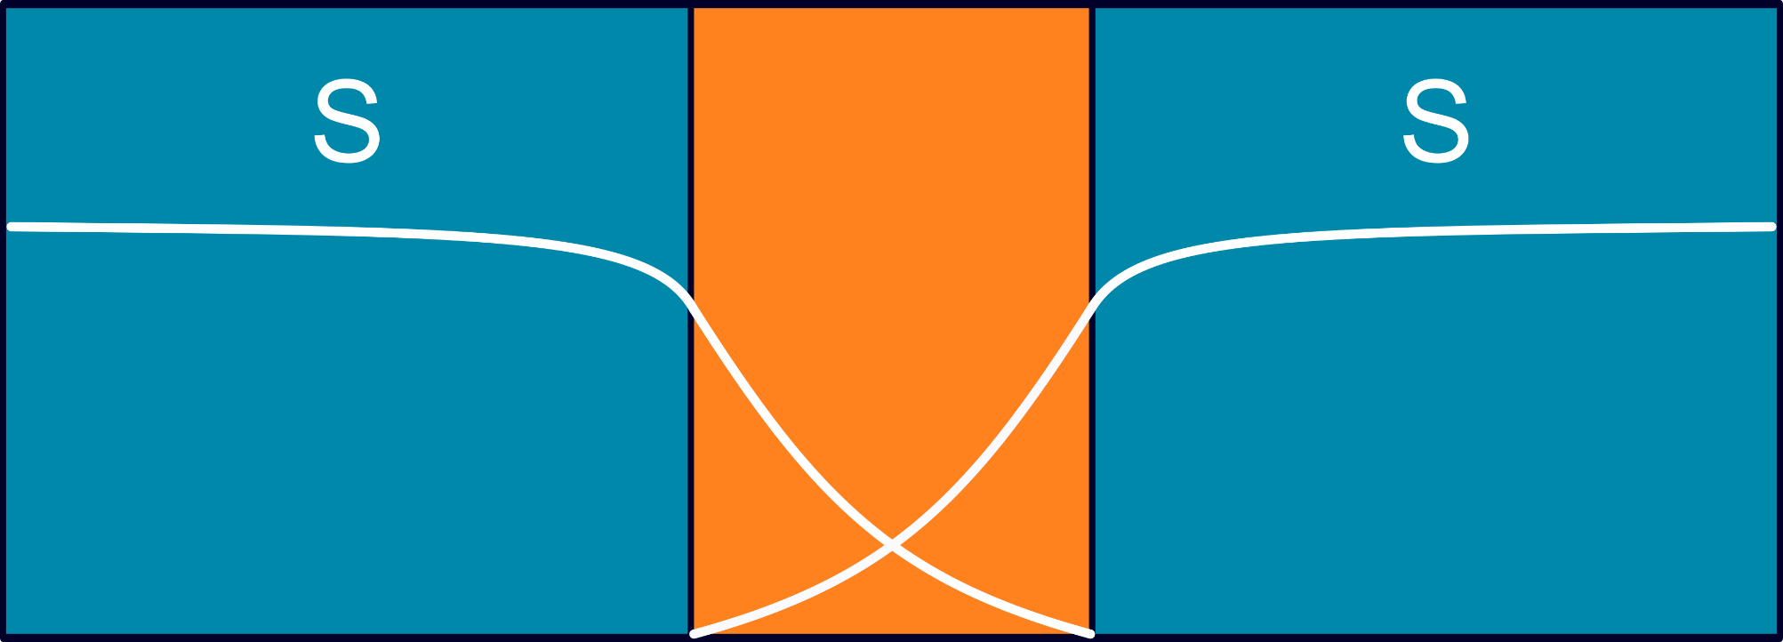




$${\left|Ψ\right|e}^{ iθ_{1}}$$
$${\left|Ψ\right|e}^{ iθ_{2}}$$
Supercurrent driven by phase difference
(not potential difference)
I_{c}
1st Josephson relation
$$I_{s}(φ)=I_{c} sin{(θ}_{1}−θ_{2})$$
$${φ=θ}_{1}−θ_{2}$$

Slide 3
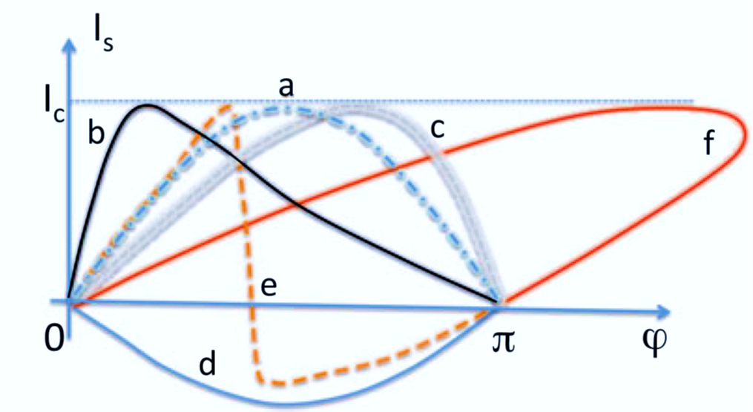

What’s a Josephson weak link?
weak link
(barrier)
Many options!
Insulator: SIS Tunnelling
Normal metal: SNS Proximity
Superconducting: SsS Constrictions
…
$${\left|Ψ\right|e}^{ iθ_{1}}$$
$${\left|Ψ\right|e}^{ iθ_{2}}$$
Depending on material & size, CPR can deviate from standard
$$I_{s}(φ)=I_{c} sin(φ)$$
But CPR must remain single-valued

Slide 4





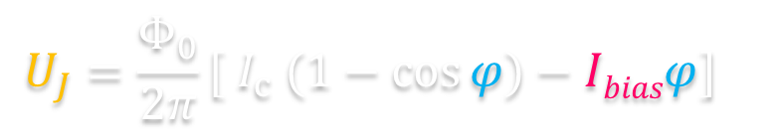

Josephson eqns:
$$I_{s}(φ)=I_{c} sin(φ)$$
Current–Phase relation $I_{bias}<$ $I_{c}$ → V = 0 (steady state)
$\frac{dφ}{dt}=\frac{2e}{\text{ħ}}U$= $\frac{2π}{Φ_{0}}$ $U$
Voltage–Phase relation
$I_{bias}>$ $I_{c}$ → V ≠ 0 (dynamic regime)
$$E_{J}=\int_{0}^{t}{I_{s}V dt}$$
$$=\int_{0}^{φ}{{(I}_{c} sin⁡φ) (\frac{Φ_{0}}{2π}\frac{dφ}{dt}) dt}$$
Periodic Josephson potential
$$U_{J}=\frac{Φ_{0}}{2π}[ I_{c} (1−\cos{φ})−Ibiasφ]$$
Tilted washboard analogy
Phase → Position
Voltage → Velocity
Bias current → Driving force (the tilt)

Slide 5
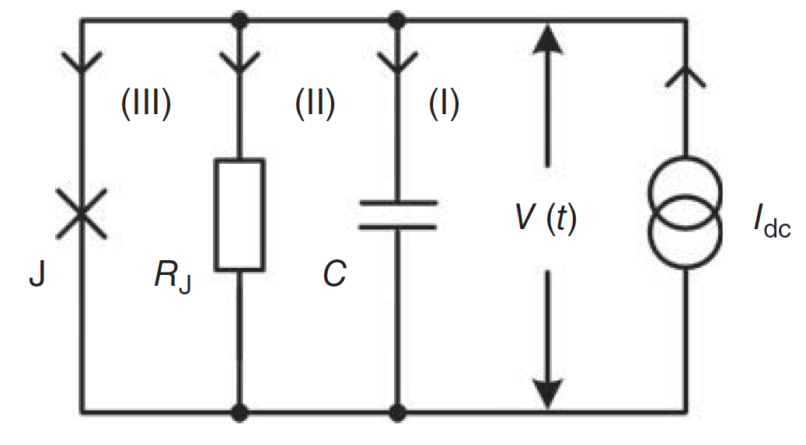
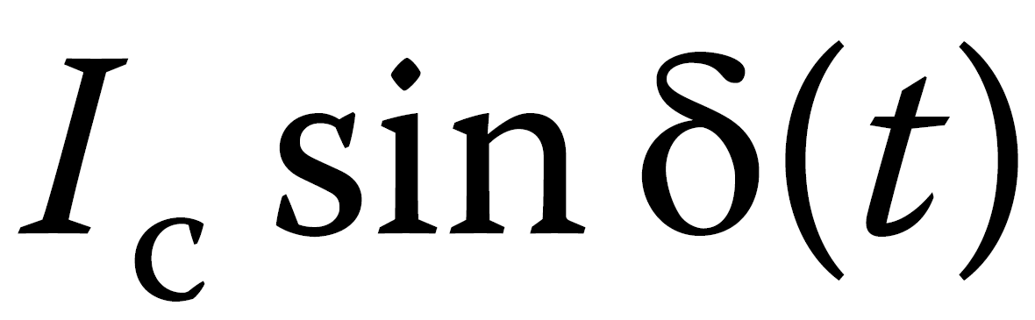
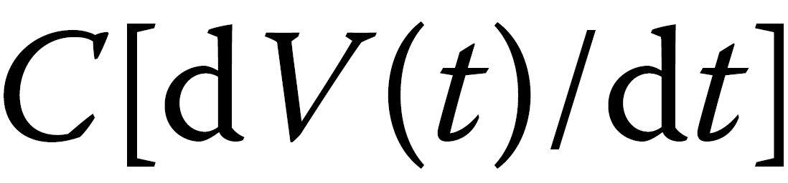


RCSJ Model
JJs have R & C (high if SIS, small if SNS). But we ignore R & C if $Idc{<I}_{c}$ (why?)
What happens in the JJ when $Idc{>I}_{c}$ ?
JJ
An ac voltage appears across the circuit (parallel to the JJ)
→ 3 different currents: 1 AC supercurrent + 2 normal (unpaired es) channels
Phase (here written as δ) → Position (x)
Voltage → velocity
Capacitance → Mass (m)
Friction → Conductance (1/R)
Bias current → Driving force (F_{d})

Slide 6
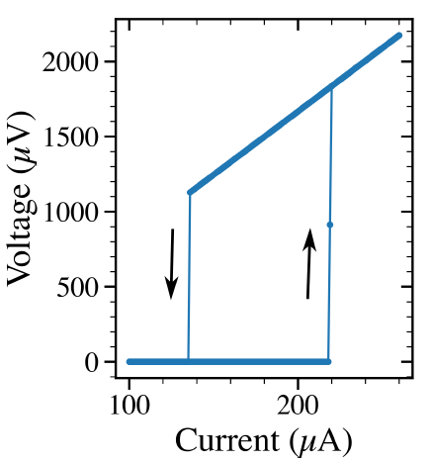
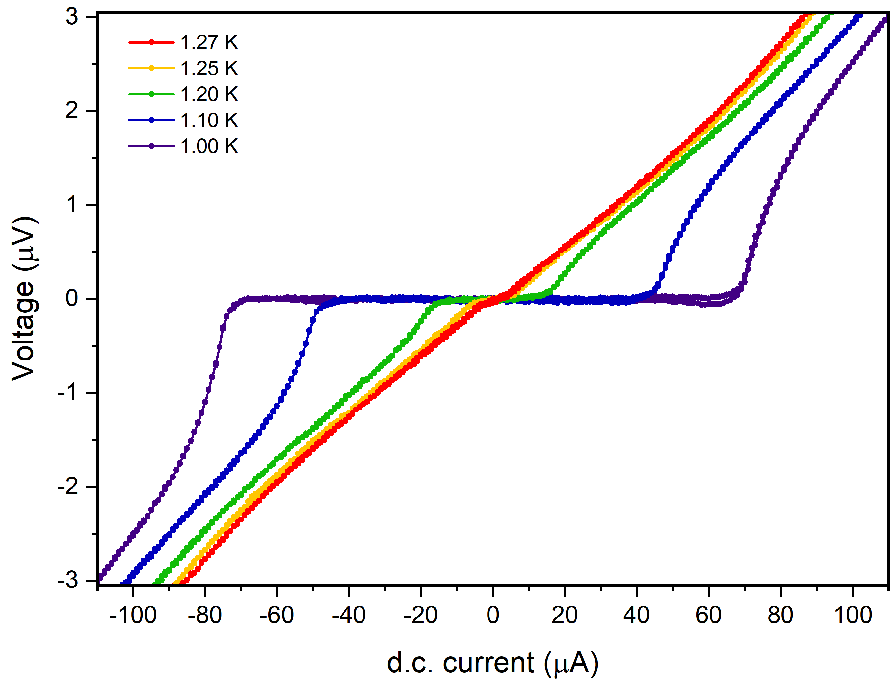


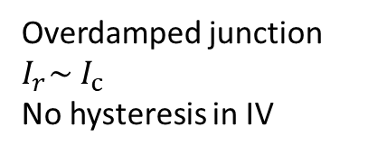


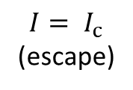
Making sense of I-Vs with the tilted washboard
$${I= I}_{c}$$
(escape)
Underdamped junction
$$I_{r}<{ I}_{c}$$
Hysteresis in IV
$${I= I}_{r}$$
(re-trap)
$$I_{r}$$
$$I_{c}$$
Phase → Position
Voltage → velocity
Capacitance → Mass
Friction → Conductance
Bias current → Driving force
Overdamped junction
$$I_{r}\sim { I}_{c}$$
No hysteresis in IV

Slide 7
Making sense of I-Vs with the tilted washboard
Phase → Position
Voltage → velocity
Capacitance → Mass
Friction → Conductance
Bias current → Driving force
Au
Nb
Nb
$$I_{r}$$
$$I_{c}$$
Au
SNS (Nb/Au/Nb)
https://doi.org/10.1103/PhysRevB.77.165408
Angers, Chiodi, et al
Which JJ would have a larger hysteresis in their IV? Why?
Dieter Koelle et al
SIS (Nb/Al-AlOx/Nb)
https://doi.org/10.1515/9783110456806-012

Slide 8

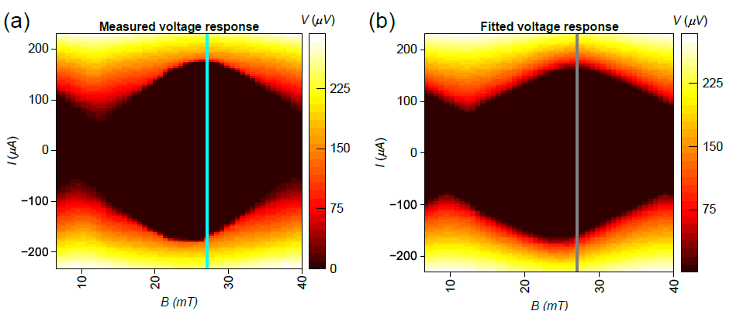
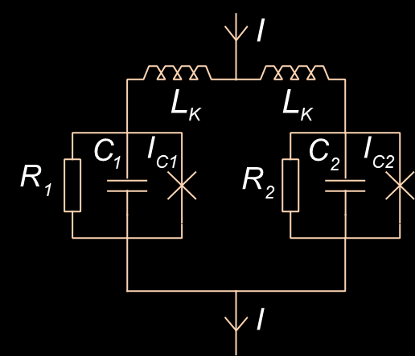
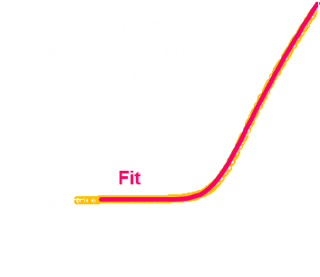
RCSJ Modelling
Measured I-V as a function of field
Matthijs Rog
(Lahabi lab)
Simulated RCSJ
(neural network)

Slide 9



Back to dynamic regime:
Weak Link
$$\dot{φ}(t)=\frac{dφ}{dt}=\frac{2e}{\text{ħ}} V$$
$$I_{s}= I_{c}\sin{φ(t)}$$
When V≠ 0, an AC supercurrent develops across the JJ
Josephson supercurrent oscillates at
$ω_{J}=\frac{2π}{Φ_{0}}V$; $f_{J}$=$\frac{V}{Φ_{0}}≈483.6$ GHz / mV
(time-averaged voltage)
Oscillating supercurrent → Oscillating EM field
JJ generates microwaves
In what frequency range?
The voltage across JJ can vary from nV up to 10s of mVs

Slide 10
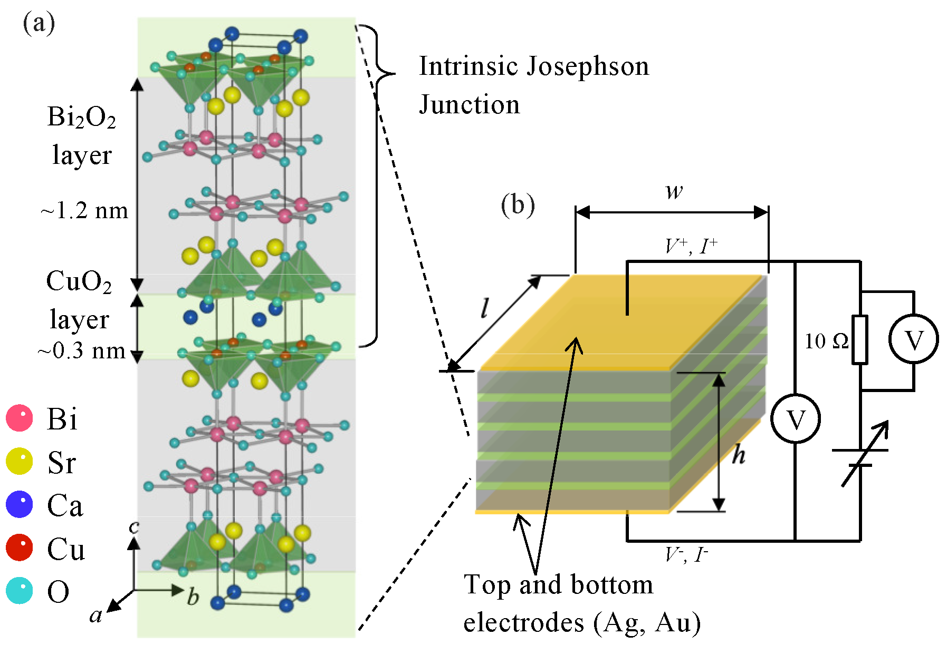

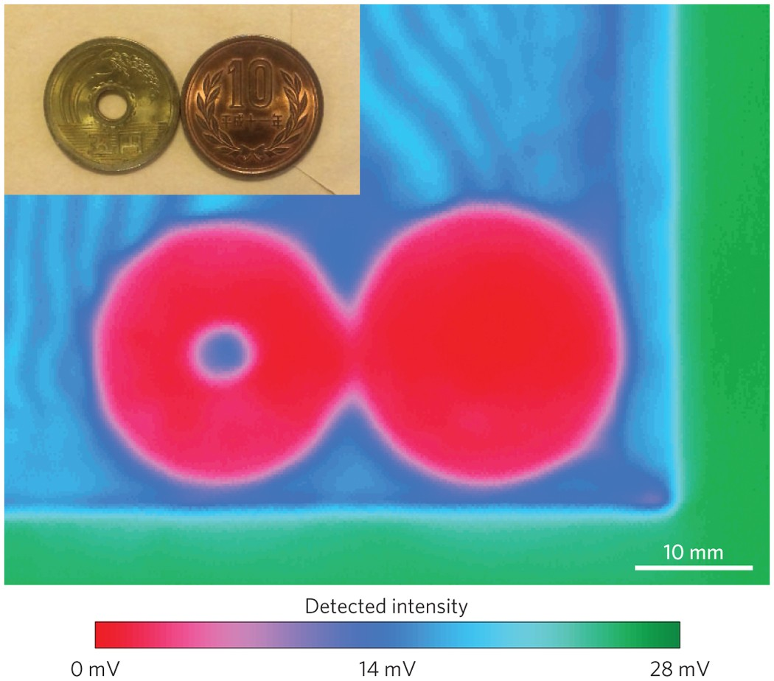

Using JJs as high-freq generator
Weak Link
Closing the so-called THz gap (0.5–1.3 THz) with
intrinsic JJs in cuprates
$f_{J}$=$\frac{V}{Φ_{0}}≈483.6$ GHz / mV
“Imaging of coins in a mail envelope using a 0.537-THz beam generated by a 62-μm-wide mesa that is operated in the high-bias regime⁹¹. …fringes caused by reflections between the paper sheets of the envelope are visible in the blue region of the image”
DC supercurrent → Generates RF
The reverse?

Slide 11
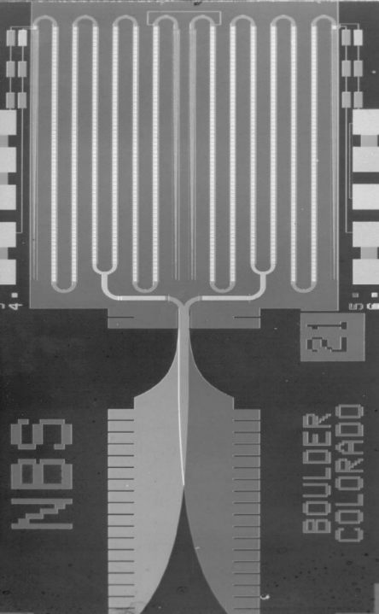
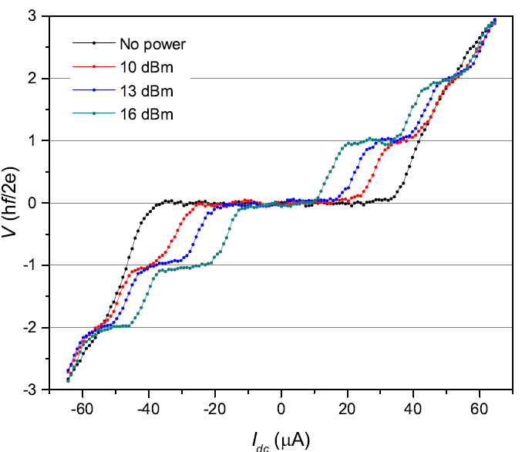
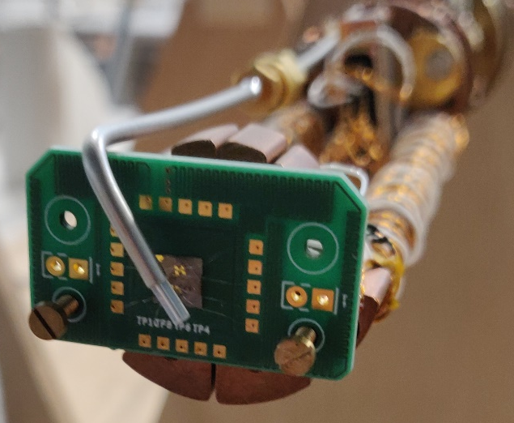

Shapiro Steps:
Weak Link
Quantized steps in I-V, when JJ irradiated by microwaves
Step height: V = $f.Φ_{0}$
Step width $∝$ microwave power ($∝$ magnitude of induced I_{rf})
Standard unit of voltage
open-ended coax (GHz antenna)
JJ (Measured in DC)

Slide 12
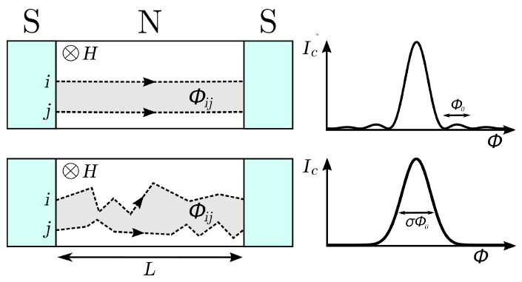
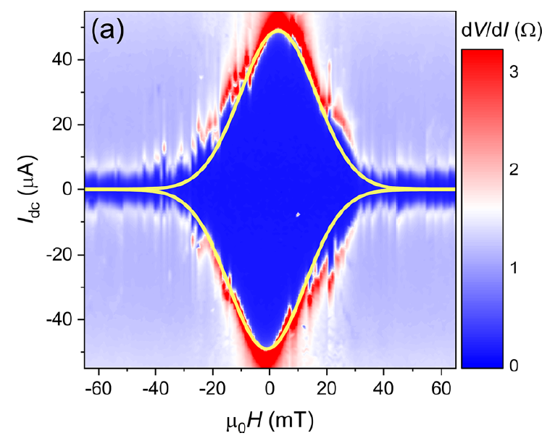
Fraunhofer Pattern (other considerations)
Long diffusive JJ
Blom,… Lahabi ACS NANO (2020)

Slide 13
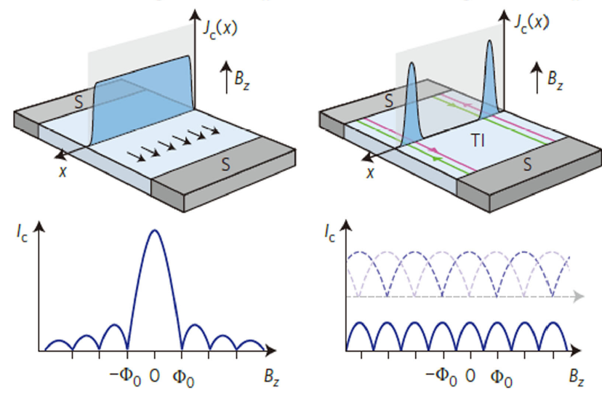
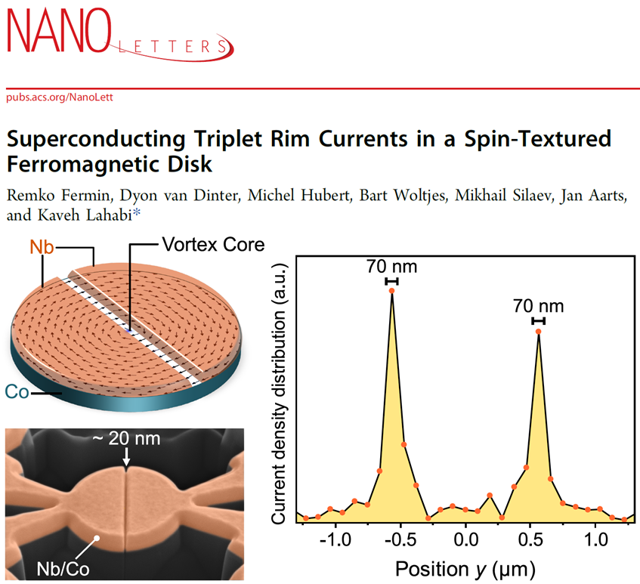
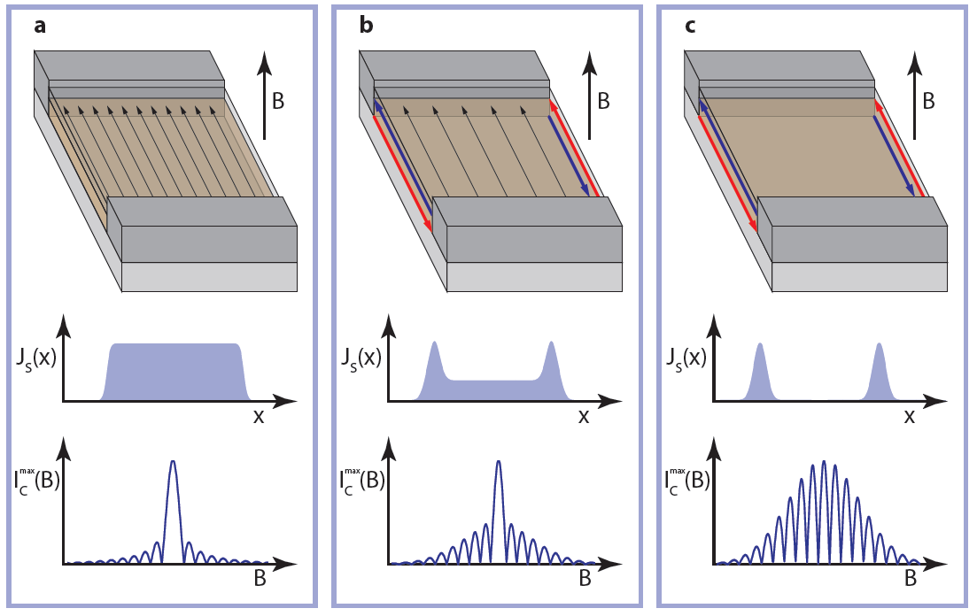
Dependence on the spatial distribution of critical current density J_{c} (x)
Hart, S. et al. Nature Phys. 10 (2014)

Slide 14
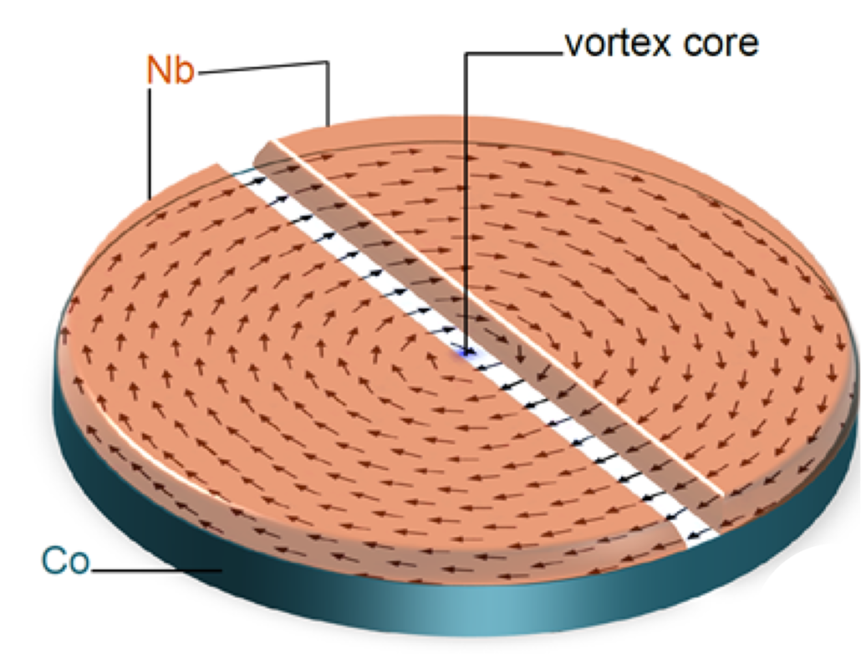
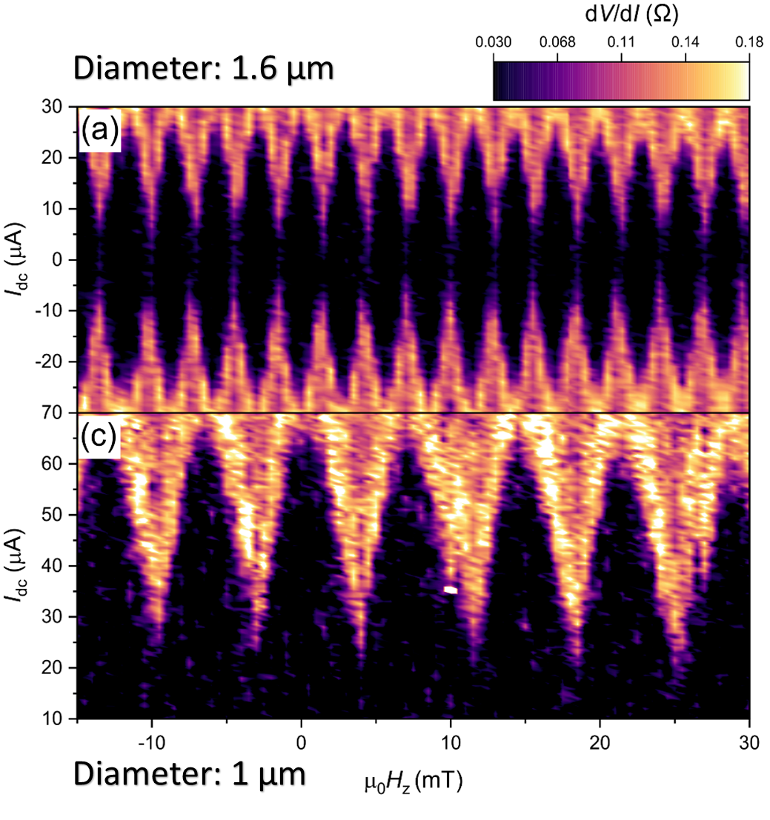
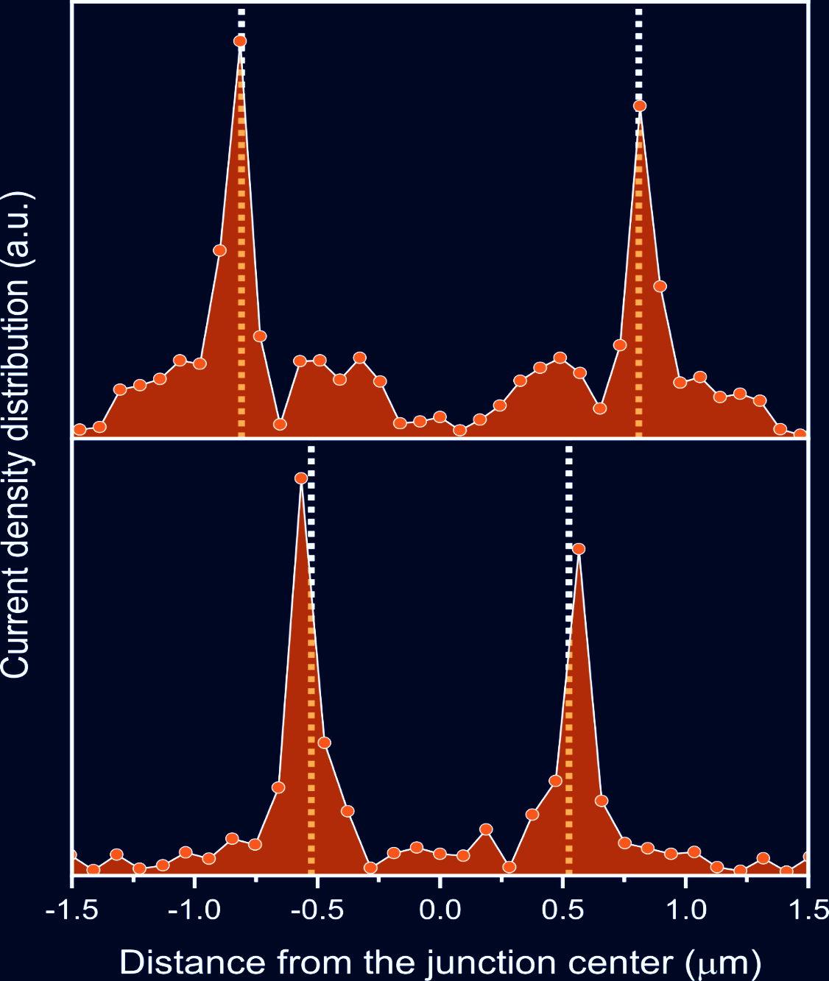
Spin-triplet rim currents (an unsolved puzzle)
Transport channel < 80 nm
Fermin,… Lahabi Nano Lett. (2022)

Slide 15
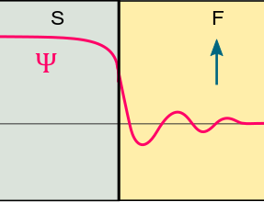
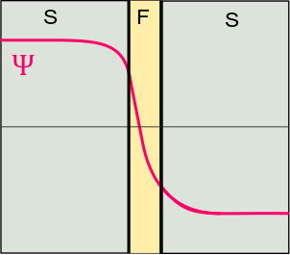
Different classes of JJs (according to their potential)
0-junction
π-junction
How does Ic (B) of a π-JJ differ from a 0-JJ? (see homework)

Slide 16
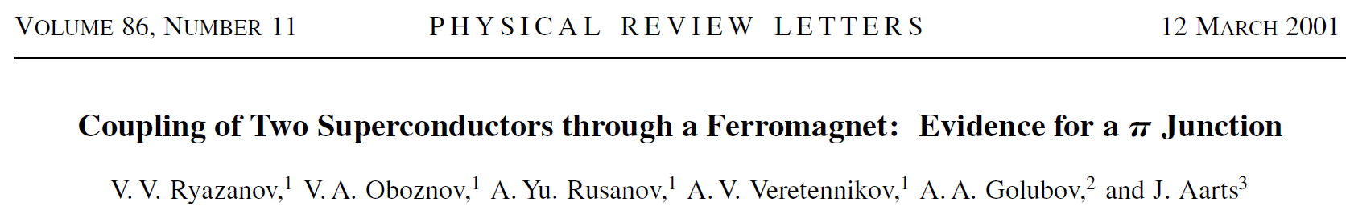
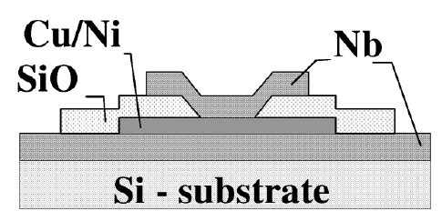
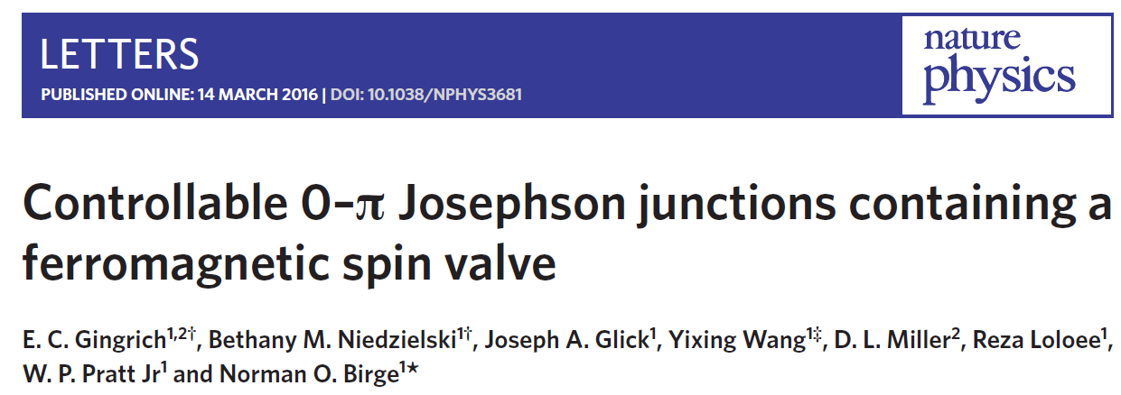
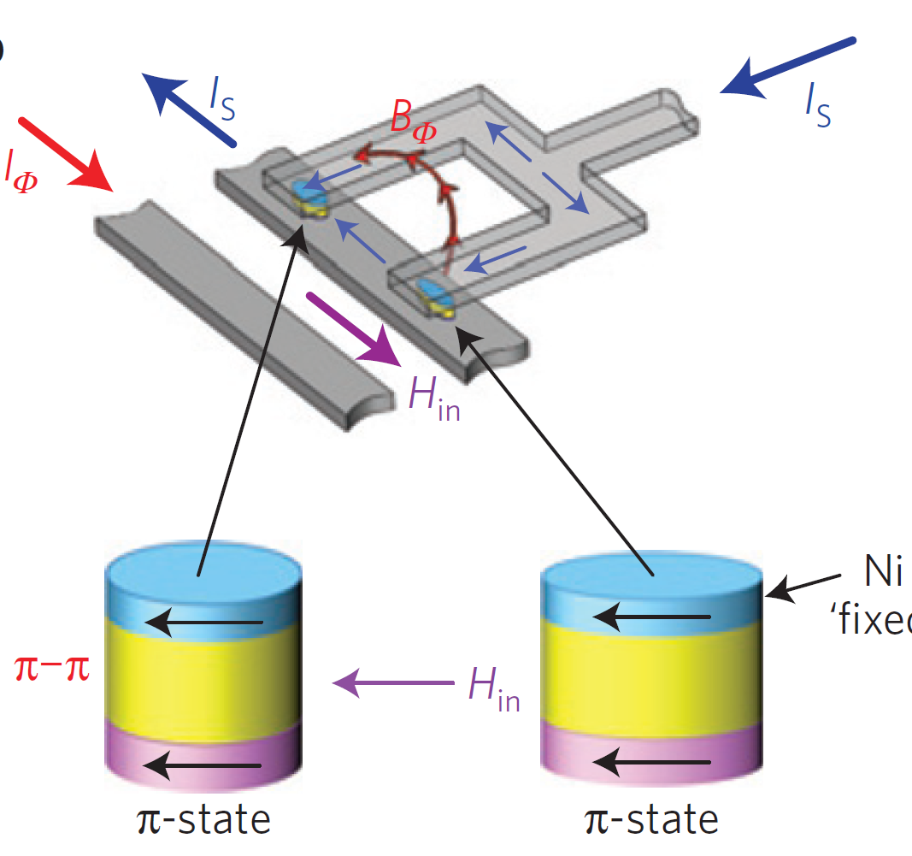
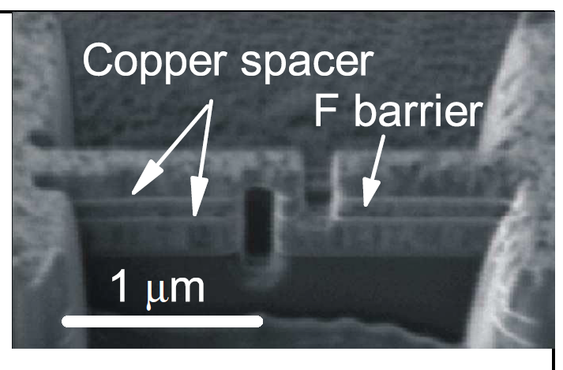
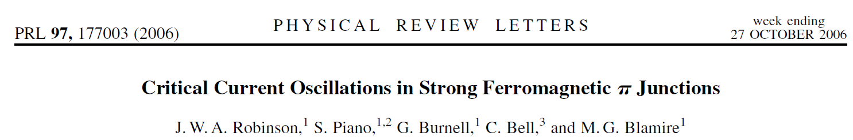

Slide 17
Transport channel < 80 nm

Slide 18
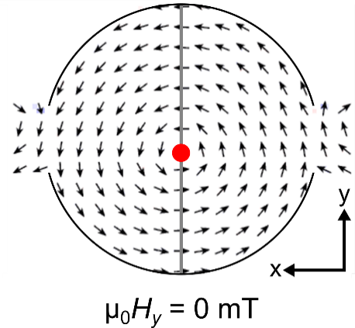
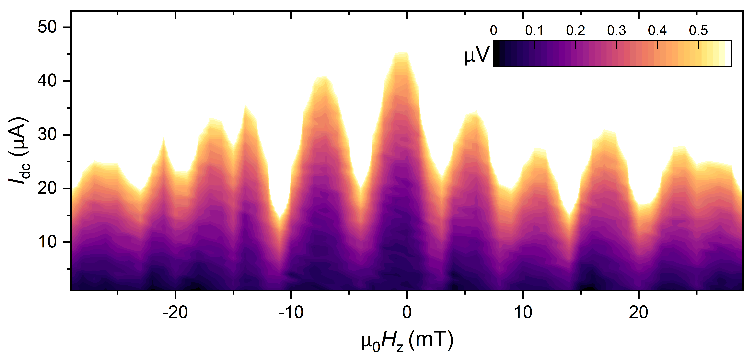
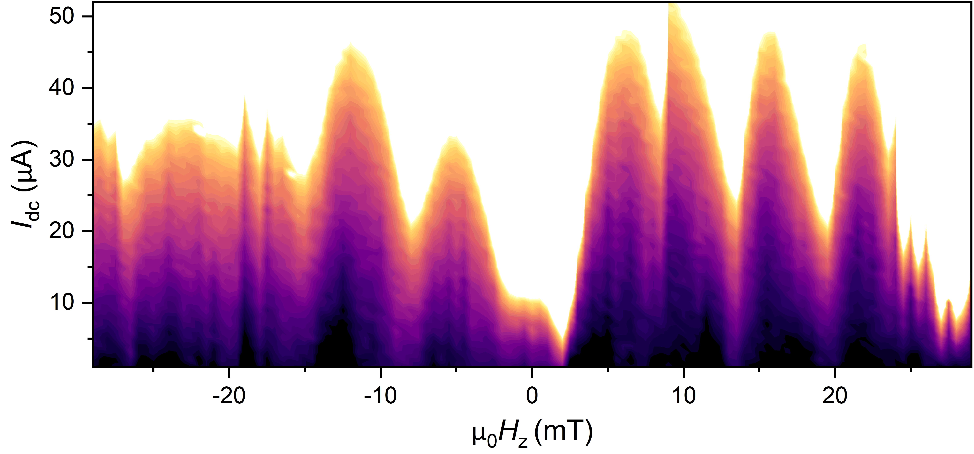
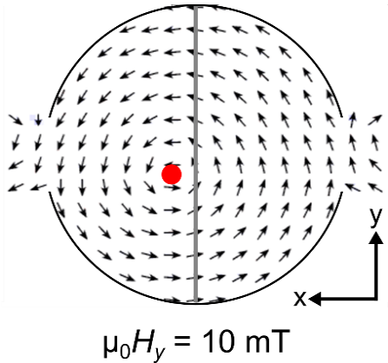
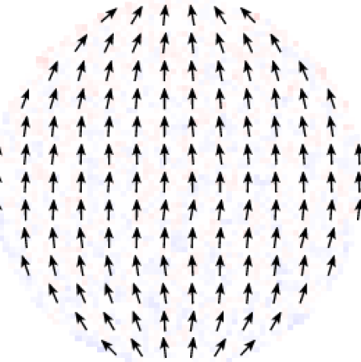

Switching the phase of triplets using spin texture: 0-0 to 0-π
B_{z}
B_{y}
B _{in-plane} = 10 mT
Asymmetric pattern: 0-π SQUID
B _{in-plane} $\sim$ 80 mT
No vortex → no supercurrent

Slide 19
Grain boundary JJs in cuprate SC films
Which GB config makes a π-JJ?
Notes:
Thank you for the introduction, now let me get started. Hello everyone, for the one who is unfamiliar with the talk-too much face: I’m nick Nick Groen and I have been working on the manufacturing and measuring of three-dimensional superconducting nanostructures.
Thank you for the kinded worded introduction, for those who don’t know me, I’m Nick Groen and for the last several months I have been working on the fabrication of superconducting three-dimensional nanostructures.

Slide 20
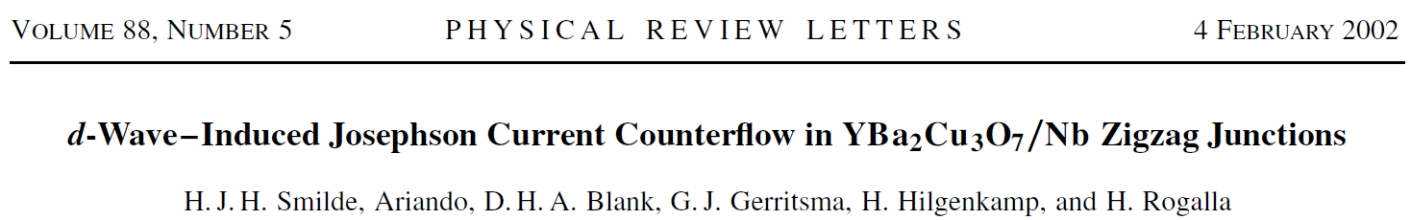
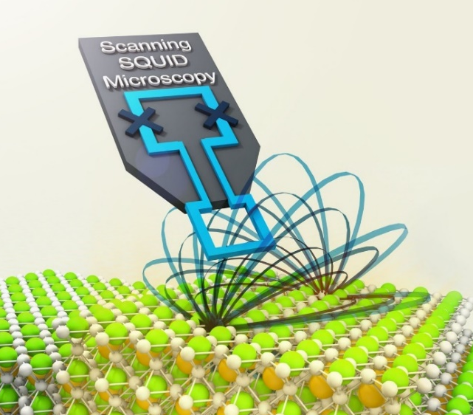
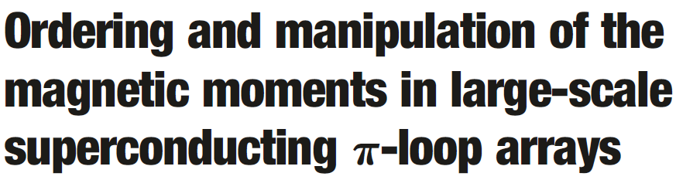
0-π Junctions: zig-zag junctions formed between facets of a YBCO crystal & Nb film

Slide 21
0-π Junctions: SFS Junctions with 0 and π segments

Slide 22



More exotic cases: Phase batteries
$φ$-junction
$φ$₀-junction
Homework:
What would I-V sweeps of a $φ$-junction looks like?
Spontaneous TRSB

Slide 23
Bonus slides:
Time-reversal symmetry breaking in Josephson devices

Slide 24
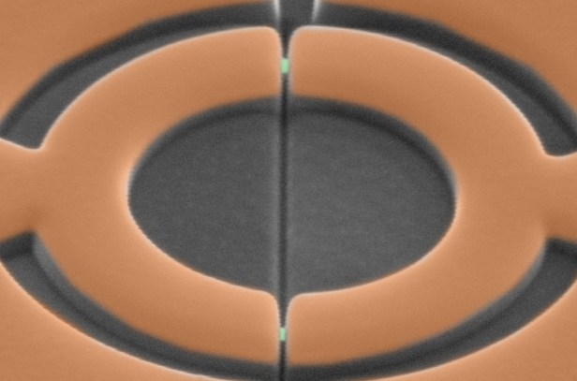
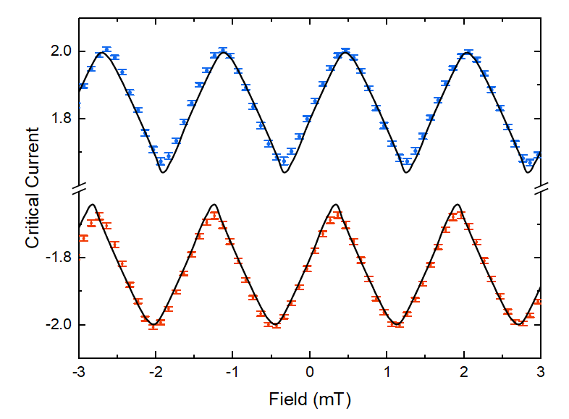
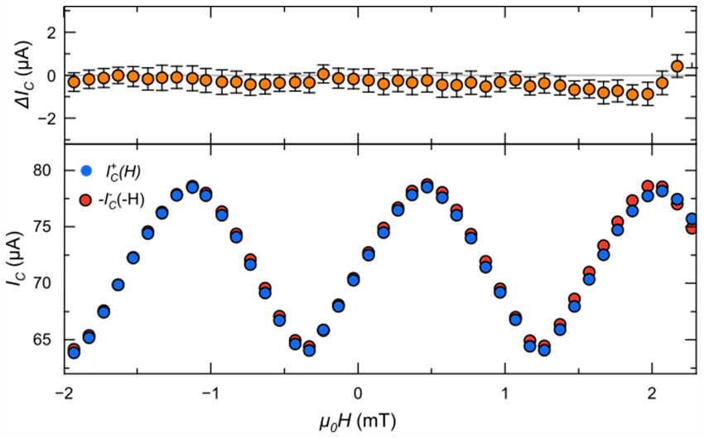
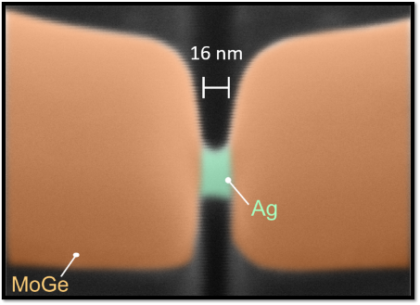
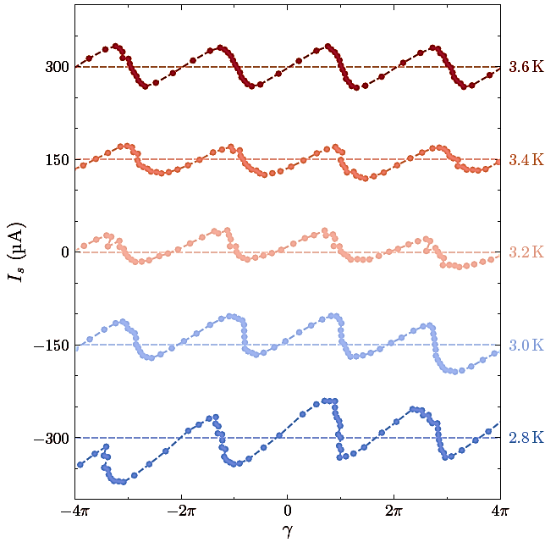
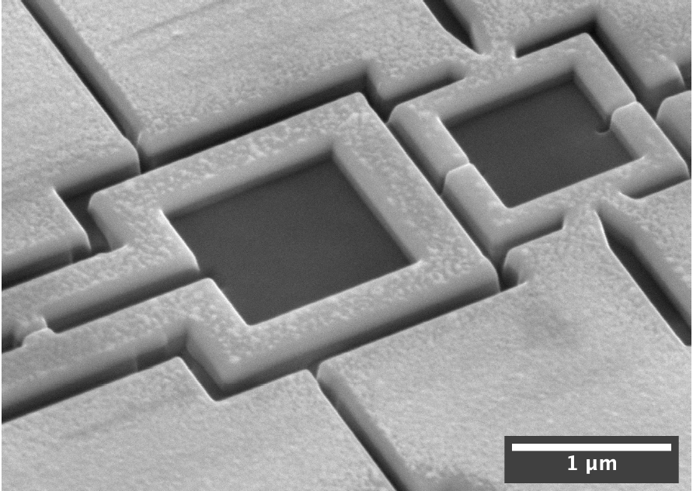




Time-reversal Symmetry (TRS)
$$I_{C}^{+}\left(+H\right)=I_{C}^{−}(−H)$$
Δ$I_{c}$= $I_{C}^{+}\left(+H\right)−I_{C}^{−}\left(−H\right)=0$
$$I_{C}^{+}$$
$$I_{C}^{−}$$
Matthijs Rog & Julian Doorn
(Lahabi Lab)
CPR Measurement

Slide 25





Time-reversal Symmetry (TRS)
$$I_{C}^{+}\left(+H\right)=I_{C}^{−}(−H)$$
$$I_{C}^{+}$$
Δ$I_{c}$= $I_{C}^{+}\left(+H\right)−I_{C}^{−}\left(−H\right)=0$
$$I_{C}^{−}$$
CPR measurement
Matthijs Rog
& Julian Doorn

Slide 26













TRS breaking: Josephson devices
Superconducting rectifiers and diodes
$φ_{0}$- Junction
External magnetic field + Spin-orbit + gating

